Slide 1

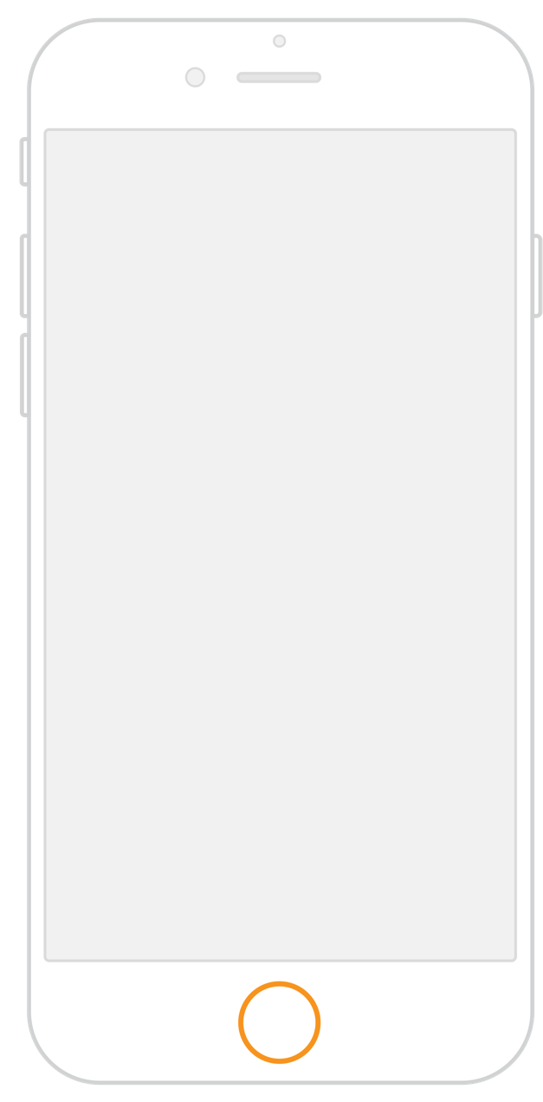
Synchronize your data on all devices

Slide 2



How to get our app
Click on this link to download the app
01
Install the app on your device
02
Click on “Add account”
03
Click “other server”
04
Type: https://cloud.open365.io
05
Use the login info we gave you
06

Slide 3
To help open source community to move forward…
We want to host the most awesome ideas
… and for that we need your help!
To ensure privacy to our users’ data
Send us
your feedback!

Slide 4


Did you know…
Here is our cloud hosted
Our servers are NOT here

Slide 5

@open365
http://open365.io
Notes:
You can safely remove this slide. This slide design was provided by SlideModel.com – You can download more templates, shapes and elements for PowerPoint from http://slidemodel.com
<number>

